Slide 1

Basic Details of the Team and Problem Statement
Ministry/Organization Name/Student Innovation: AICTE, MIC-Student Innovation
PS Code: SIH1487
Problem Statement Title: Student Innovation
Team Name: Syntax Loopers
Team Leader Name: Chirag Nahata
Institute Code (AISHE): C6260
Institute Name: JIS College of Engineering, Kalyani
Theme Name: Clean & Green Technology

Slide 2
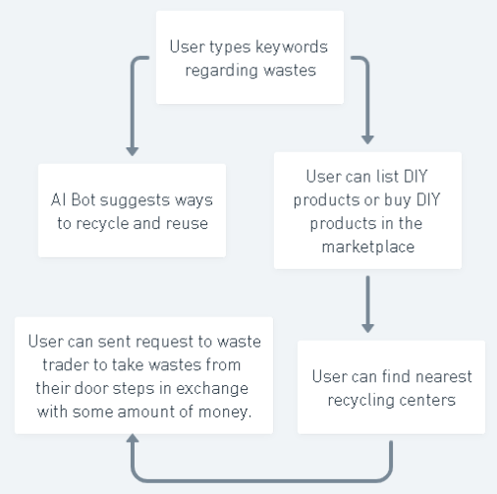













Idea/Approach Details
We're looking for a solution by creating a web-based application that will serve as a platform for users to get rid of accumulated
plastic and other recyclable waste at home while also benefiting technologically. The Prototype will function as follows
Identifying the Bio-degradable plastic wastes through image screening using Artificial Intelligence (AI) and Machine Learning (ML) and making them reuseable or recycled.
User can get ways to recycle or reuse the wastes by our Ai chat bot built with openai api by just typing keywords.
User can also get to know about the nearest waste recycle centers from our software and call the waste traders to their door steps to take away the waste in exchange of some amount of money.
User can also shop or list their hand made DIY products made by waste materials from our marketplace section present in the web app and can make extra chunk of money.
Technology stack:
HTML, CSS, JS, MYSQL, PHP, PYTHON, FLASK, XAMPP, Replit, NodeJS, NextJs ,MongoDB and openai api.

Slide 3
Idea/Approach Details
Describe your Use Cases here
Describe your Dependencies / Show stopper
here
Domestic use case (User can find ways to recycle and reuse domestic wastes)
Professional uses (User can recycle and reuse wastes professionally )
Can be used to track wastes in region basis.
Providing a secure employment to those vendors who had unstable sources of income and were collecting recyclables door-to-door.
Even also to provide a side source of income to the talents of india who have skills to create DIY products made up from wastes and sell those to our platform.
Users can donate a set amount towards the planting of a tree at the end of each purchase of recycled plastic items, the geographical location of which will be shared with the user later.

Slide 4
What Problem we are solving?
Problem:
According to International Trade Administration(ITA) Our Country India produces 60 million Tons of waste Materials every year.
And The major sources of waste are Indian households. Indeed, Indians are old trash, but the quantity of junk and garbage that is thrown out of the houses all across the world is huge. Year after year, it can add up to millions of tons of waste materials that find their way into the landfills.
Solution:
So we are solving this huge problem by creating an ecosystem between the common peoples , Waste Vendors and The DIY products creators.
So by help of our made system user can get knowledge how to recycle or reuse the wastes by just typing keywords or taking snap of the item to our Ai enabled chat bot.
Even the user can view the nearest recycle centers present nearby and can give a request to waste vendors to take away the wastes from their door steps in exchange of fix amount of money per kg or grams.
And user can buy or sell DIY products too in our same platform Marketplace also.

Slide 5
Buissness Idea:
Market size:
As per STATE ENVIRONMENT PLAN - West Bengal Pollution Control Board, West Bangal produces 13,708.58 Tonnes per day (TPD). And the main component of this tonnes of waste is 43% plastic and 22% E-Wastes.
So if we only focus on that 43% of plastic waste then WB produces 5894.68 tonnes of plastic waste per day.
And intresting fact is that only 10% of those plastic wastes are get recycled and rest remain as it is in Dhappa landfill.
Therefore, as per calculations total non recycled plastic wastes are about 5305.212 tonnes per day
As we know 1 tonne = 1000kg – therefore, 5305.212 tonnes in kg = 5,305,212 kg per day
And as 1 kg of waste plastic is costed about Rs.9/- …
hence total cost of those plastic waste generated per day is about Rs. 47,746,908 (forty-seven million, seven hundred forty-six thousand, nine hundred eight) per day only in just WB.
And if we conqueror just 10% of the total market then the revenue will be Rs.4774690.8 (four million, seven hundred seventy-four thousand, six hundred ninety) per day and for total year it will be of Rs. 1,742,762,142 (one billion, seven hundred forty-two million, seven hundred sixty-two thousand, one hundred forty-two)only just in West Bangal.
And Intresting fact is that if we can reuse those E-wastes then the revenue will get increased by 10-15 times...

Slide 6
Team Member Details
Team Leader Name: Chirag Nahata
Branch (Btech/Mtech/PhD etc): B.Tech Stream (ECE, CSE etc): CSE(AIML) Year (I,II,III,IV): I
Team Member 1 Name: Akash Nath
Branch (Btech/Mtech/PhD etc): B.Tech Stream (ECE, CSE etc): CSE(AIML) Year (I,II,III,IV): I
Team Member 2 Name: Rohit Debnath
Branch (Btech/Mtech/PhD etc): B.Tech Stream (ECE, CSE etc): CSE(AIML) Year (I,II,III,IV): I
Team Member 3 Name: Sangjukta Bhattacharjee
Branch (Btech/Mtech/PhD etc): B.Tech Stream (ECE, CSE etc): ECE Year (I,II,III,IV): I
Team Member 4 Name: Biki Mukherjee
Branch (Btech/Mtech/PhD etc): B.Tech Stream (ECE, CSE etc): ECE Year (I,II,III,IV): I
Team Member 5 Name: Aditya Biswas
Branch (Btech/Mtech/PhD etc): B.Tech Stream (ECE, CSE etc): CSE(AIML) Year (I,II,III,IV): I
Team Mentor 1 Name: Type Your Name Here
Category (Academic/Industry): Expertise (AI/ML/Blockchain etc): Domain Experience (in years):
Team Mentor 2 Name: Type Your Name Here
Category (Academic/Industry): Expertise (AI/ML/Blockchain etc): Domain Experience (in years):

